Slide 1



GenePattern Notebook
Running Analyses
Notes:
At this point you should have a high-level, rather abstract idea of what GenePattern is and what its goals are. This is important because it lays the groundwork for the rest of the workshop today.
.
In this section, however, we’re going to dive and get our hands dirty, using GenePattern to run a computational genomic notebook.

Slide 2
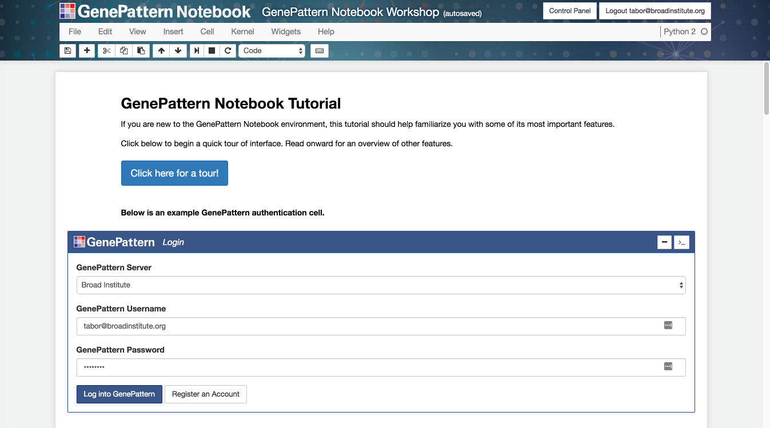
GenePattern Notebook Environment
Notes:
This will use one of GenePattern’s newest features – the GenePattern Notebook Environment. This environment allows you to perform in silico research and present that research in the form of an interactive notebook in your web browser.
.
It also allows you to easily reproduce research conducted by others and encapsulated in a notebook document.
.
You can also think of the GenePattern Notebook like this: If you work in a wet lab, a bench biologist has an ever-present lab notebook. For computationalists, however, there is no real equivalent. GenePattern Notebook helps bring these worlds together, so that you can keep your notes and your computational analyses together in an easy-to-understand, narrative format.
.
And this format is really intuitive. It’s a lot like how you might conceive of your research. And it's also not unlike how an academic paper might be structured.

Slide 3

Jupyter Notebook
Popular and well-supported framework for scientific computing
Ecosystem of available integrations and resources
Open source
Notes:
GenePattern Notebook is built on top of a platform called Jupyter.
.
Jupyter is a popular and well-supported framework for scientific computing with a pretty vast ecosystem of integrations and other resources that are available.
.
It's open source software.
.
And the GenePattern Notebook Environment lets you create bioinformatic notebooks that are compatible with it and all the associated resources that are available to you.

Slide 4




Complete Research Narrative
Leverage the best of Jupyter and GenePattern
Interleave text, visualizations, graphics and analytical aspects
Notes:
One of the underlying goals of GenePattern Notebook is to encapsulate a complete research narrative—from its conception to dissemination.
.
Another goal is to make all of the powerful GenePattern features available in the notebook environment. This way a researcher can leverage the best of what Jupyter and GenePattern has to offer, interleaving text, graphics, interactive visualizations and analytic aspects.

Slide 5
Exercise
Notes:
Alright, alright, so enough talk. Let’s dive right in. Sometimes the best way to learn is by doing.
.
So with that in mind, we’re going to do a bit of a follow-along exercise. And I’m going to explain things as we go.

Slide 6
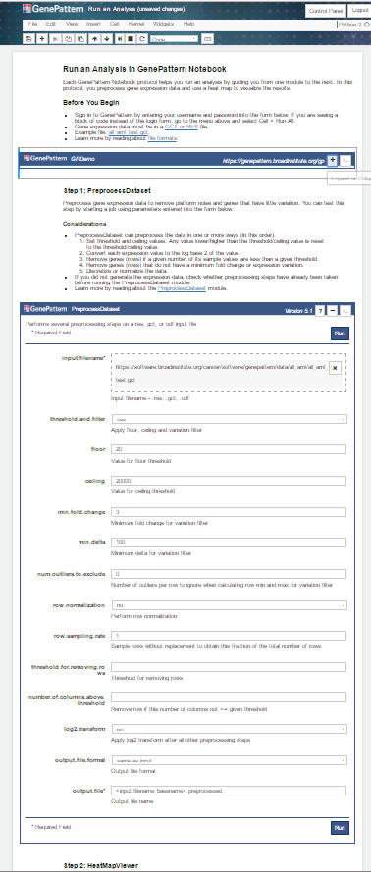
Notebook Exercise #1
Register via notebook.genepattern.org
Run an analysis notebook
Notes:
In this exercise we’re going to reproduce a very simple workflow.
.
In this workflow we will start with gene expression data from BRCA cancer samples. We will then perform some basic preprocessing and view a heatmap of the expression values from these samples.
.
Before we can do that, however, each of you first needs to register for an account – if you haven’t already done so. After you register, it should automatically log you in to the GenePattern Notebook Repository
.
So if you haven’t already, go to the web address you see up on the screen and register for an account.
.
**Give them some time to do this.**

Slide 7
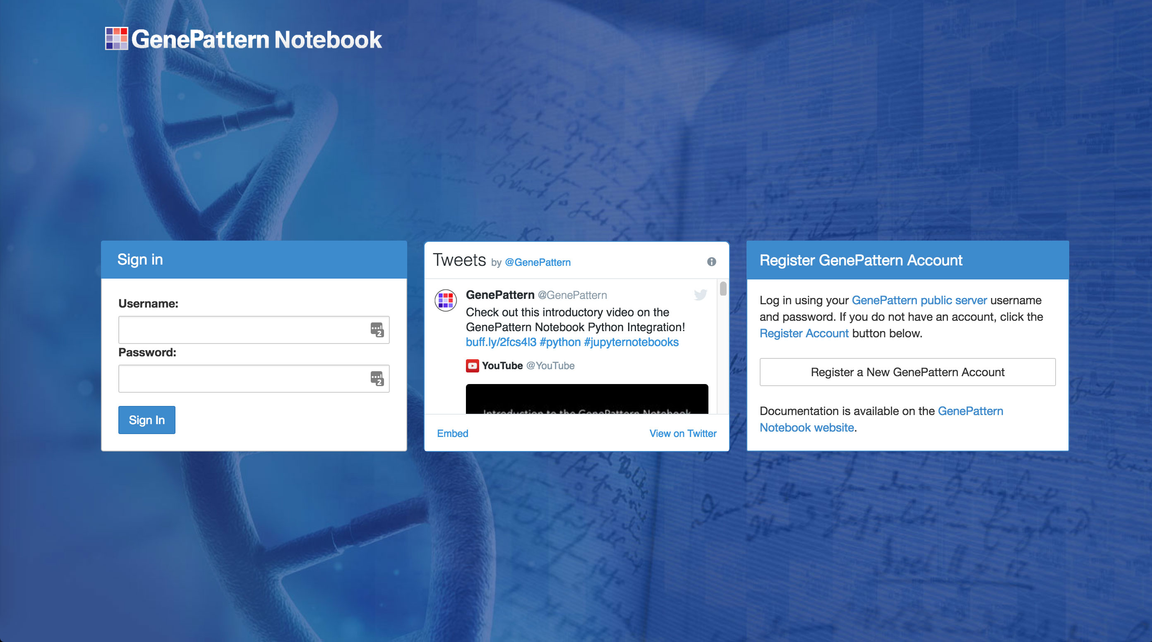
GenePattern
Notebook Repository
https://notebook.genepattern.org
Notes:
When go to the web address you should have seen a login page that looks something like the one I’m showing up on the screen.
.
Welcome to the GenePattern Notebook Repository. This is a free online resource that lets you develop, share and publish computational genomic notebooks. You can use it with your own research, or you can use it to browse through the public notebooks in the repository and use them to reproduce a variety of popular methods.
.
And as you can see, there’s a “Register an Account” button in the righthand box, and the login form on the left.

Slide 8
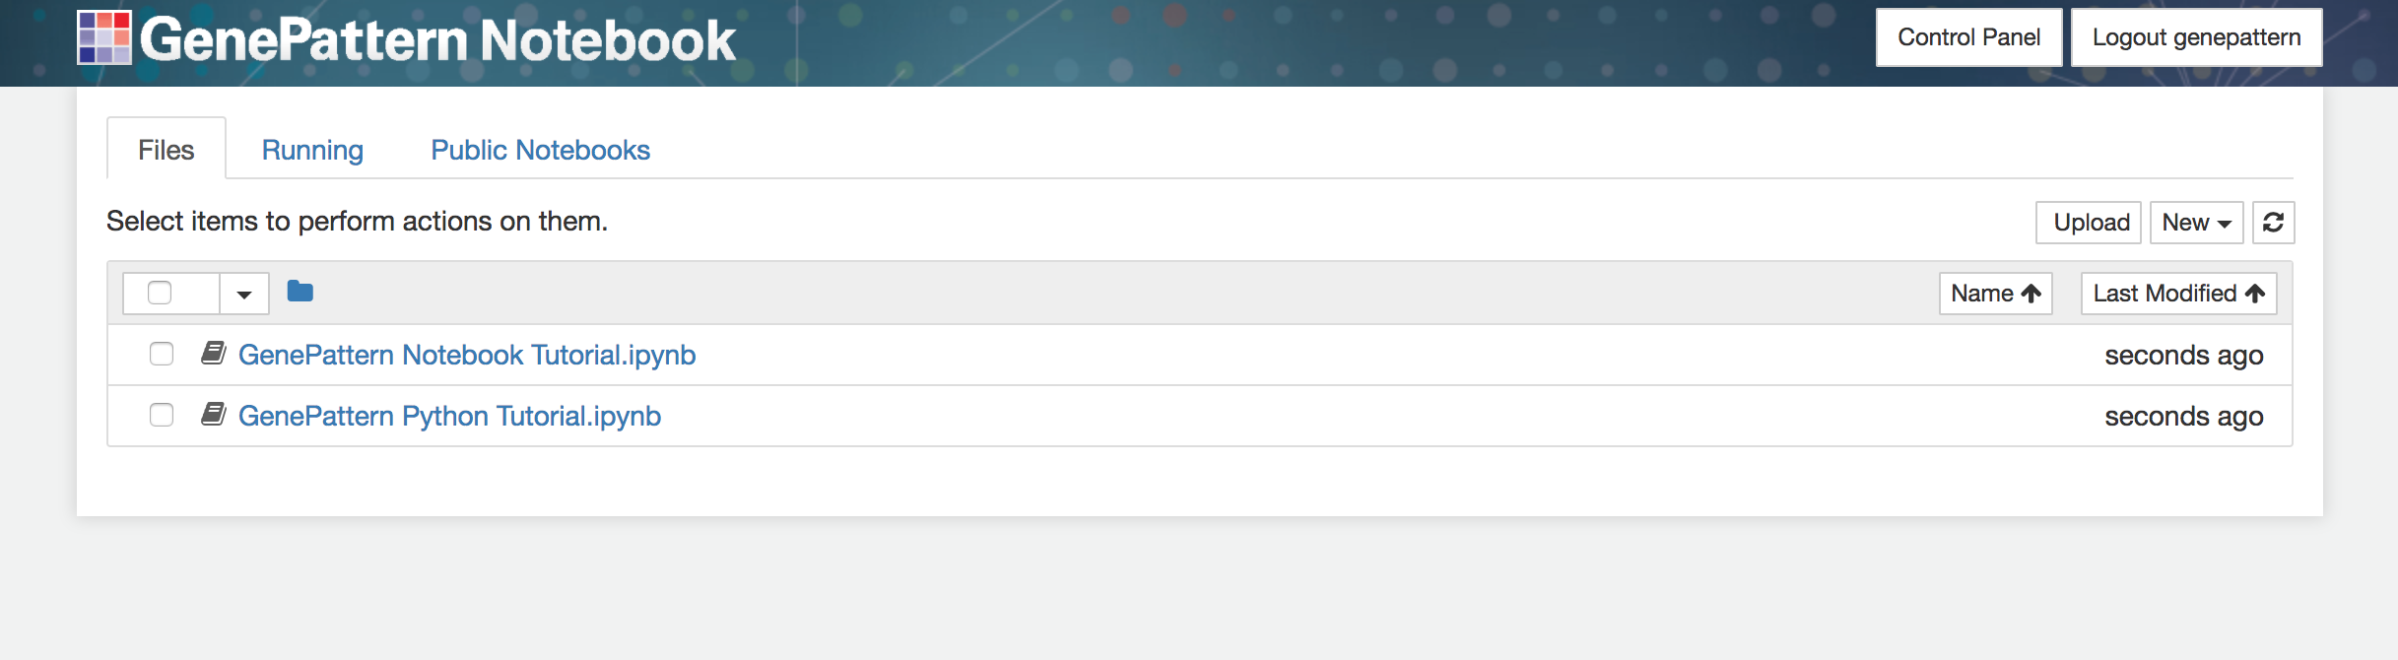
Notebook Workspace
Lists your private notebooks and associated files.
Copy, move, rename, delete, download and publish notebooks from here.
Notes:
Once you’ve registered, it should automatically log you in and bring you to a page that looks like the one you see up on the screen now.
.
On this page you should see a list of the notebook files you have in your personal and private workspace. By default you’re going to have two files when you first register, and these are both tutorial notebooks that show off the available features.
.
Later you can run them at your leisure, but what we’re going to do now, however, is to browse the list of published notebooks for the method that we want to reproduce.

Slide 9
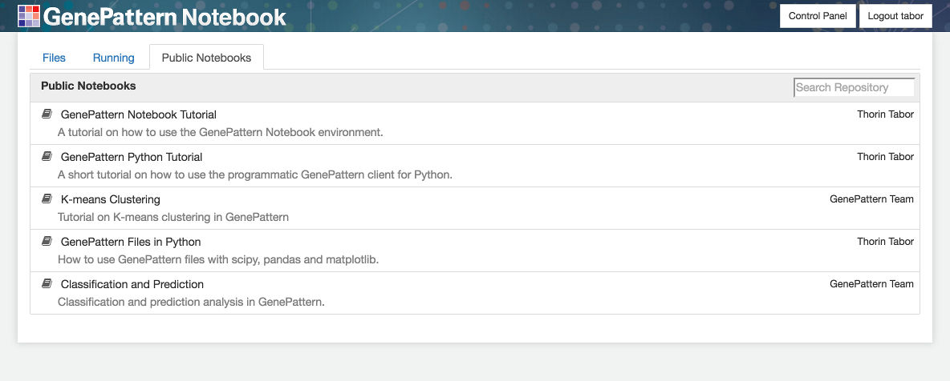
Browse Public Notebooks
A variety of public notebooks are available in the GenePattern Notebook Repository.
Anyone can make a copy of these notebooks to read, run and reproduce.
Notes:
You will notice that on the current page there are a number of tabs near the top. Right now we’re on the Files tab, which shows your notebook files, but there is also a Running tab and a Public Notebooks tab.
.
To browse the available public notebooks, we’re going to click on the Public Notebooks tab and look through the list. You will notice that if you hover your mouse over the name of each notebook in the list, it will display a short description.
.
These notebooks cover a variety of topics, from how to use the GenePattern Notebook environment itself, to common biological or machine learning tasks, such as differential expression analysis, clustering, classification and prediction.
.
However, we’re going to start with something very basic. So go ahead and locate the 2017-11-07_02 CCMI GenePattern Notebook notebook in the list and then click it.
.
**Demonstrate how to grab a copy of a notebook.**

Slide 10
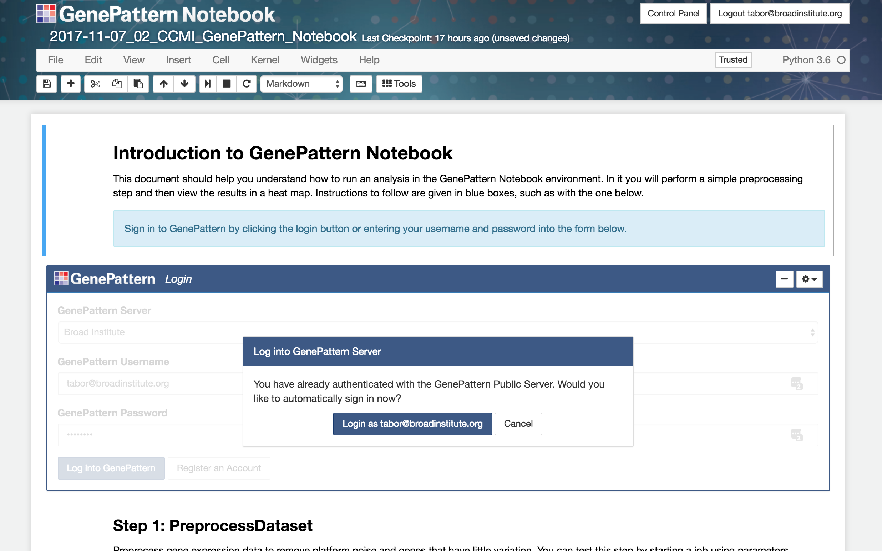
Run an Analysis Notebook
Notes:
Once you have made a copy of the notebook and opened it, you will be brought to a new tab displaying the contents of the selected notebook..
.
It should look something like what you see up on the screen.
.
Has everyone caught up to this point? **Wait and see**
.
Okay, then I’m going to go ahead and explain what you’re seeing in this notebook.

Slide 11
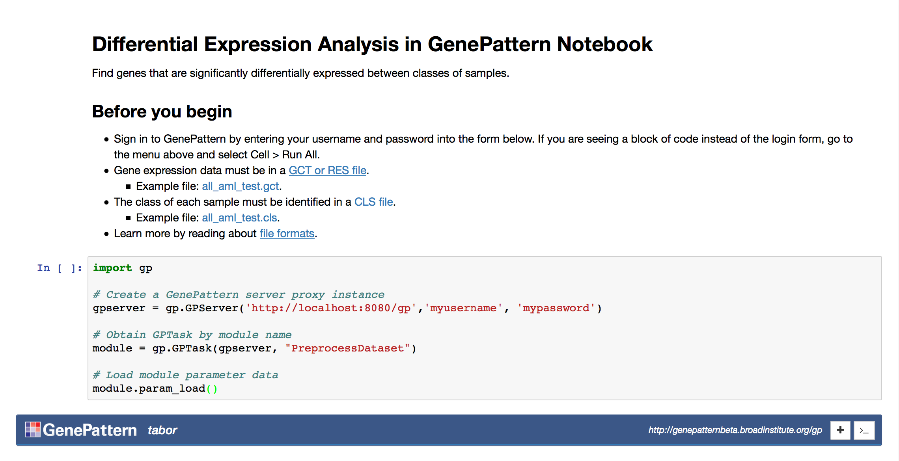
Cells
Most basic part of a notebook
Contain code, narrative text, images or interactive widgets
Notes:
Conceptually, all notebooks are divided up into blocks called cells. Each cell contains either code, explanatory text, an image to display, an interactive widget or some other element.
.
This particular notebook contains two types of cells – markdown cells and GenePattern cells. Right now I’m going to talk about how to work with cells in general, and about GenePattern cells.
.
Later on I’ll circle back and talk about markdown cells, as well as a third cell type – code cells.
.
** Show the notebook UI, select a few cells, show how to insert, delete, move and execute cells.**

Slide 12
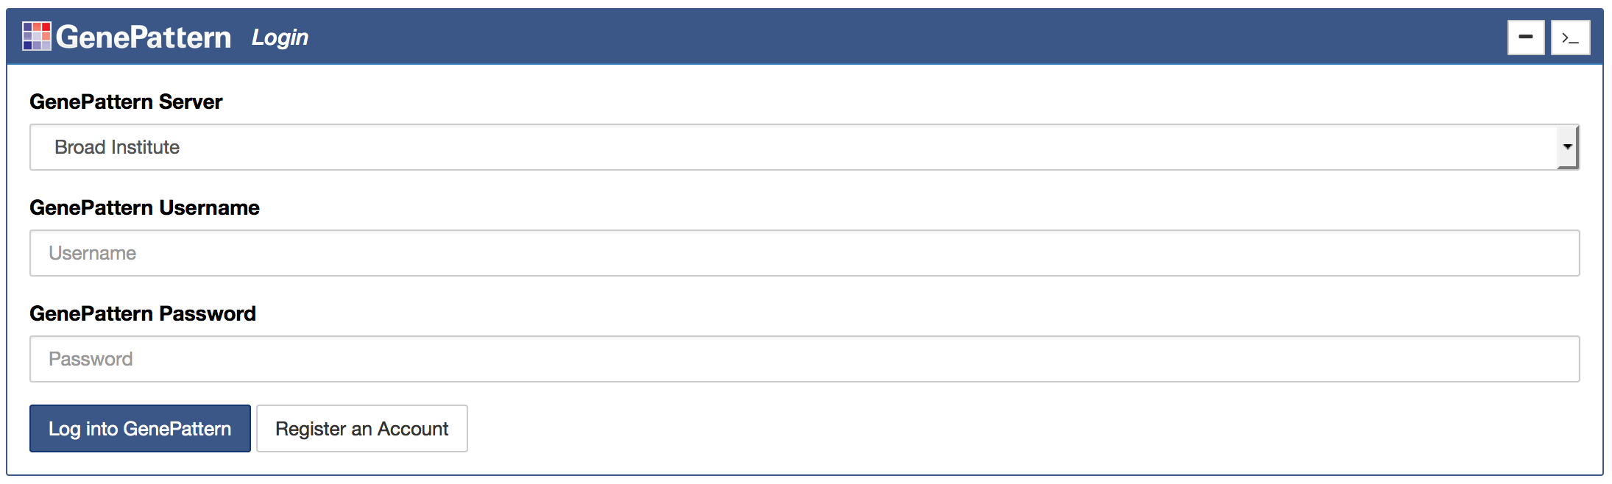
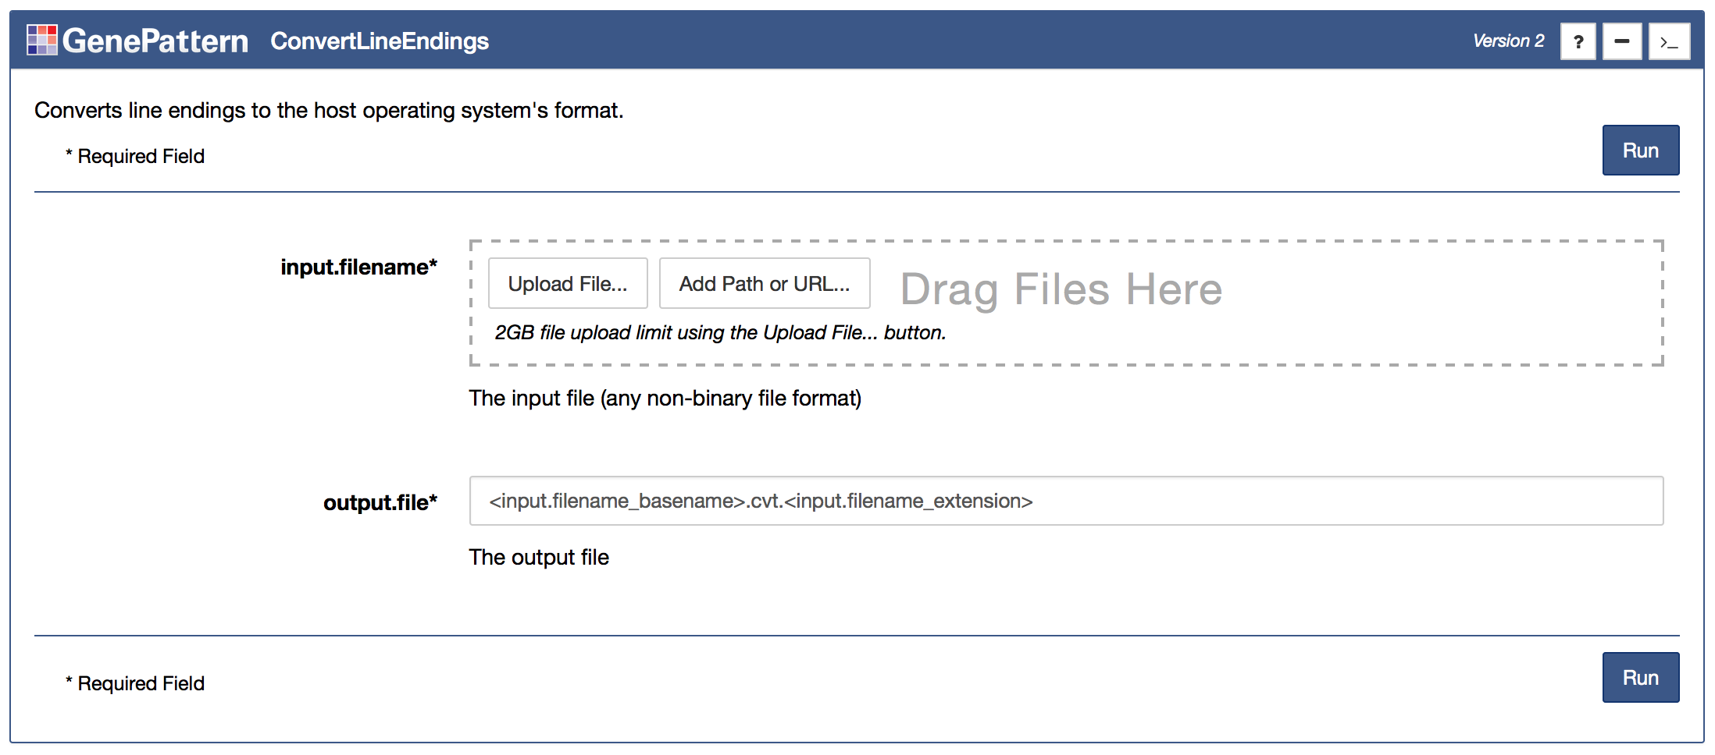
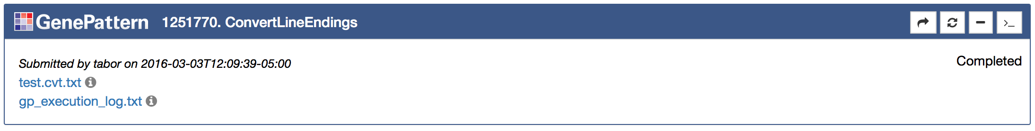
GenePattern Cells
Auth
Cell
Analysis
Cell
Job
Cell
Notes:
One of the key features provided by the GenePattern Notebook environment are GenePattern cells. These cells are rendered as interactive widgets that provide the functionality of GenePattern inside the notebook environment.
.
And there are three subtypes of these cells.

Slide 13
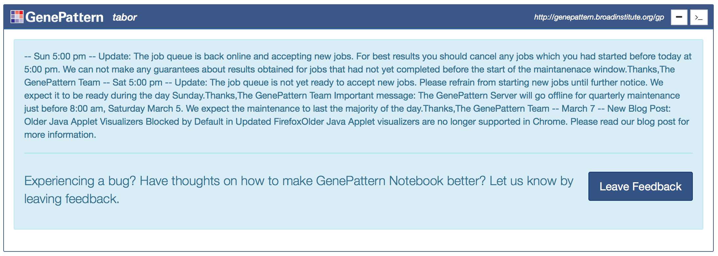
Authentication Cells
Notes:
The first, and perhaps least interesting, of these types are authentication cells.
.
These cells allow a researcher to authenticate with a GenePattern server.
.
Doing this allows data sent to the server to be kept private, or even shared with other users.
.
You will notice that the first GenePattern cell you see in the notebook is one of these authentication cells. Since you’ve already logged into the GenePattern Notebook Repository, the cell should currently be displaying a dialog asking you if you want to log in as the same user. You do, so go ahead and click the “Login as your username” button.
.
You will notice that when you do this, the authentication cell will change to display a status message from the server. And the other GenePattern cells in the notebook will also update.
.
**Give people a moment to login.**

Slide 14
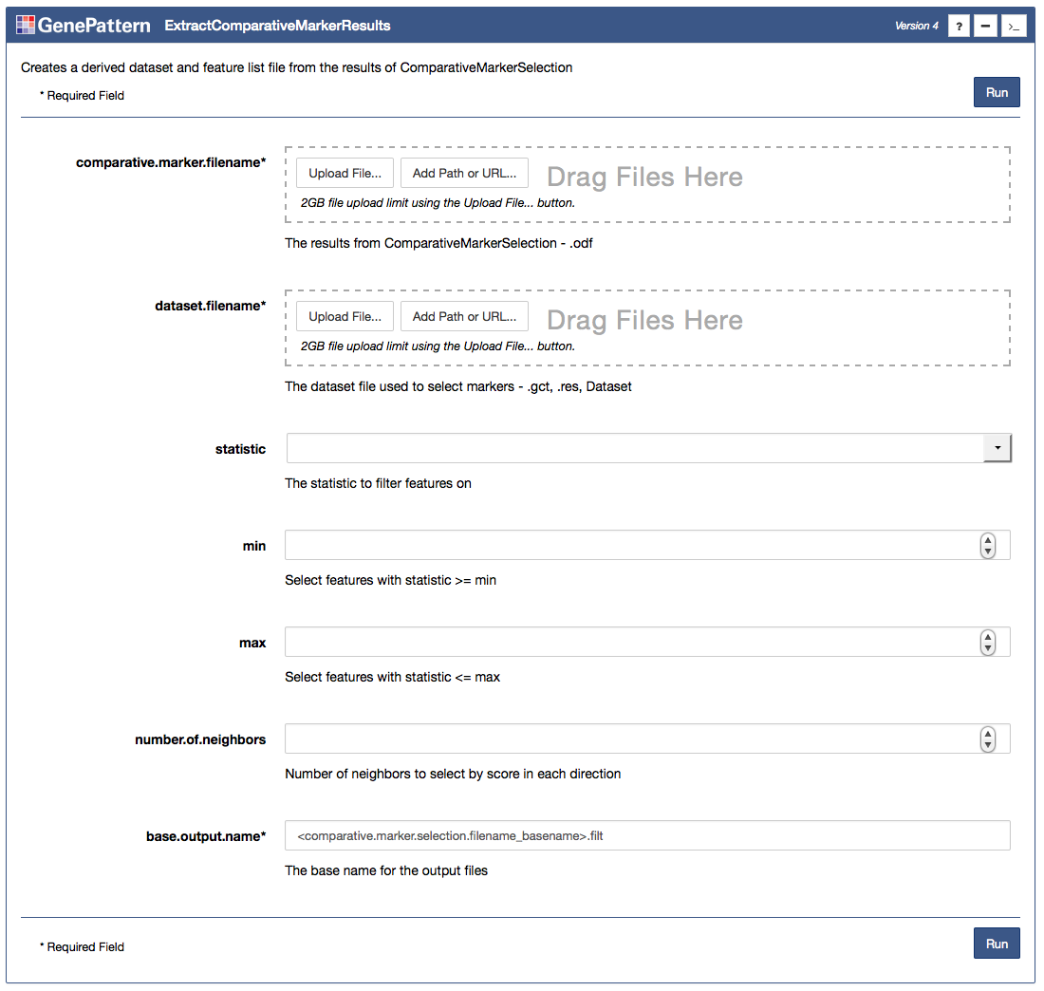
Analysis Cells
Notes:
The next type of GenePattern cells are analysis cells. And as you scroll down in this notebook, these are the other cells you see with the GenePattern logo at the top.
.
Each of these cells represent a particular analysis module in the GenePattern environment, and they each provide a simple form with the different input settings for that analysis.
.
These allow a researcher to upload data or set other parameters.
.
For example, the first one of these you see - PreprocessDataset -is for an analysis module that preprocesses data, cleaning it up for further analysis. For example, it can remove saturation effects, reduce noise or other random fluctuations, filter out genes that don’t significantly differ, etc.
.
For the purposes of this exercise, the form has already been filled out, but we want to go ahead and change one setting – the minimum fold change.
.
You will notice the instructions for that in the blue box. In fact, in all the notebooks today, the instructions you should follow will be in blue boxes like this one.
.
All you need to do is set the min fold change parameter to the correct value, then click the Run button to launch the analysis. So I want all of you to go ahead and do that now.
.
**Give them some time to do this.**

Slide 15
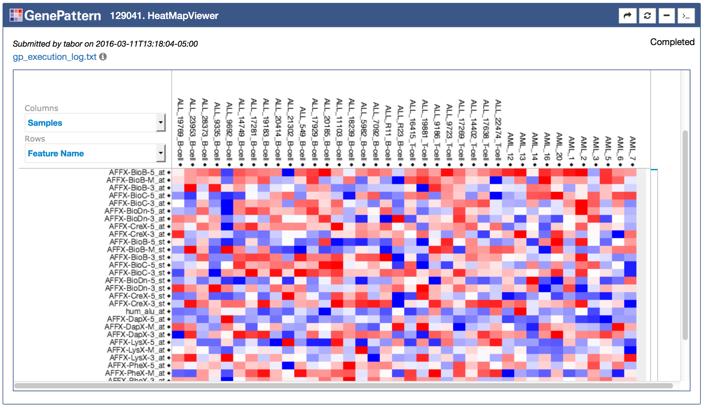
Job Cells
Notes:
The third and final type of GenePattern cell is the job cell. These cells are used to retrieve the results of submitted analyses. The results can be in the form of outputted files, such as with the top screenshot, or the results can be in the form of interactive visualizations, as with the bottom screenshot.
.
If you’ve been following along, you’ve already clicked the Run button for the PreprocessDataset analysis. And when you clicked that button it should have created one of these cells below the initial analysis cell.
.
As GenePattern jobs process they go through a series of states First they are pending, as the job waits its turn in the queue to run. Then the job is running—that is, the analysis is currently processing. And finally the job progresses to either the Completed or Error state.
.
If you look on the righthand side of the job cell, you should see your job’s current status. Output files or visualizations will appear once the job reaches the Completed state.

Slide 16
Processing...
Notes:
Since there are so many of you, it might take a few minutes for all of your jobs to make their way through the queue, from pending to complete.
.
While they’re processing, I’m going to go ahead and show you what you can do with job results once your job is completed.
.
If you can, follow along. However, if your job is still processing, don’t fret, just pay attention you’ll have the chance to do this again in the next section.
.
**Show them how to send a job result to the next step in the notebook and display a heat map.**

Slide 17
GenePattern Notebook
Conception to Publication
Notes:
In the first half of this presentation you’ve seen how to browse, run and reproduce existing GenePattern notebooks.
.
In this second half, we’re going to put those skills to use in creating a new analysis workflow from scratch. And along the way I’m going to go over some of the other features available in the GenePattern Notebook environment.

Slide 18
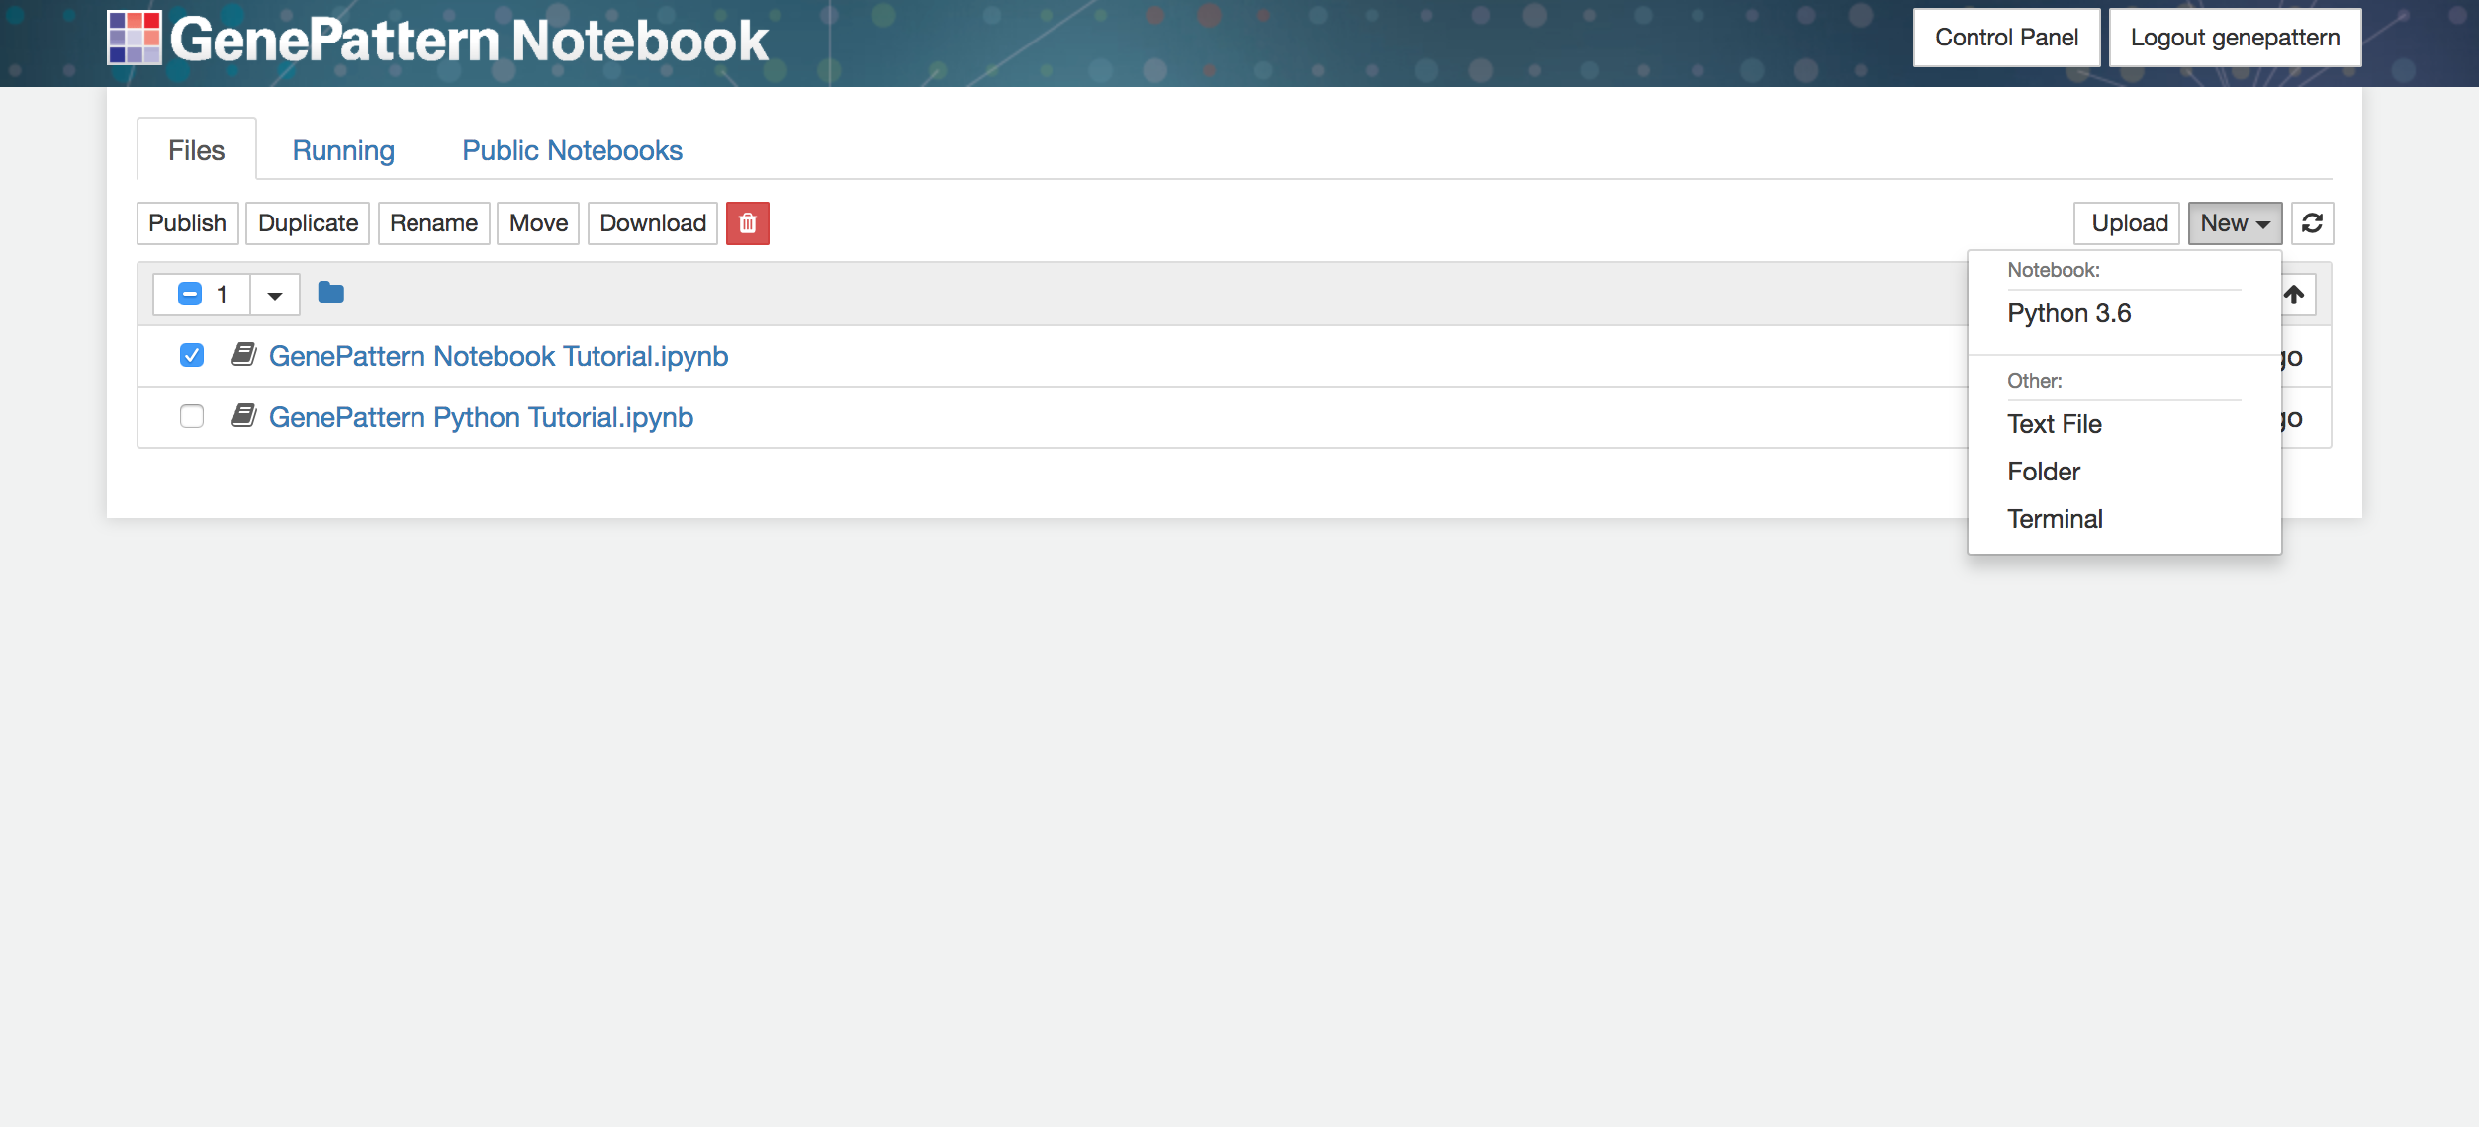
Create a New Notebook
Open the upper right menu and select “Python 3.6”
Notes:
The first thing we’re going to do is create a new blank notebook. From the files page we can do this by clicking on the dropdown menu in the upper right and then selecting which notebook kernel we want to use. In this case we’re going to select Python 3.6.
.
I also want to assure you that while you don’t need to know Python to build a notebook, if you do know it this language will be available for you to use.
.
**Make sure that everyone has opened a new notebook**

Slide 19
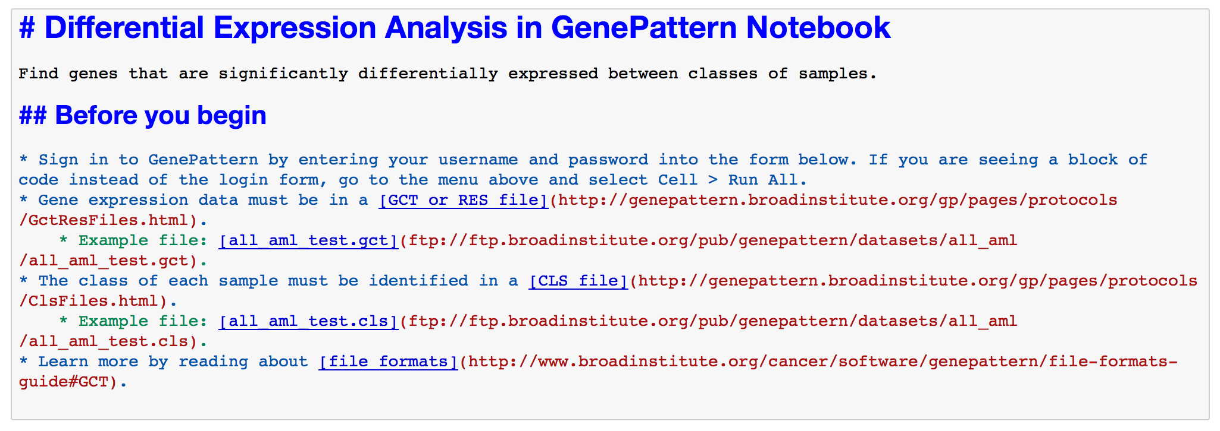
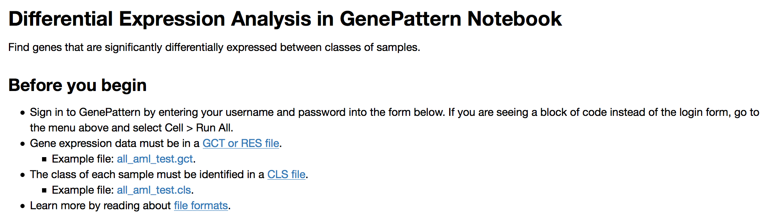
Markdown Cells
Create narrative cells using Markdown or HTML
Notes:
To begin our new notebook, I’m going to talk about markdown cells. You’ve already seen these cells in the notebook you ran earlier. But here we’re going to cover how to edit or create your own.
.
If you've ever used a web forum, wiki or typed a text email, then you've probably already written something that's very similar to markdown.
.
With markdown, you type out whatever text you want to display, along with a very simple syntax for styling that text. Then, when you execute the cell, it displays it nicely formatted.
.
You can see an example on the slide. At the top if what you type in and at the bottom is what is displayed when the cell is executed.
.
So let’s go ahead and create a markdown cell and then edit it. In this case we’re going to give our notebook a title and brief description.
.
**Show how to change cell type and then edit and execute a cell. Title will be My Preprocessing Method**

Slide 20
Markdown
Headers
  # Header Title Here
Lists
  * List item here
  * Next list item here
Links
  [Display Text Here](http://url.here)
Notes:
While you're here to learn, however, let me cover some of the most common parts of markdown.
.
On the display you can see how to create a header, how to create a bulleted list and how to create a link.
.
** Explain each.**
.
Finally, I should also note that markdown cells also support HTML. So if you know HTML, you can always use that.

Slide 21
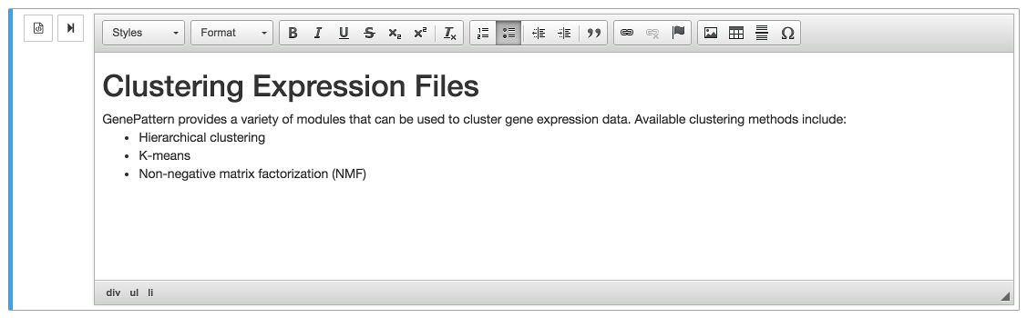
Rich Text Editor
Allows you to produce rich text without the need to write HTML/markdown
Notes:
Of course, many people aren’t going to want to learn markdown or HTML, if they’re not already familiar with them.
.
For these people, GenePattern Notebook adds a rich text editor. This editor allows you to visually create text, headings, bulleted lists, links, tables and many other elements, without the need to write in a special syntax.
.
**Explain how to use it.**
.
After you’re done, just click the “Run Cell” button and the rich text is rendered, exactly as you see it.

Slide 22
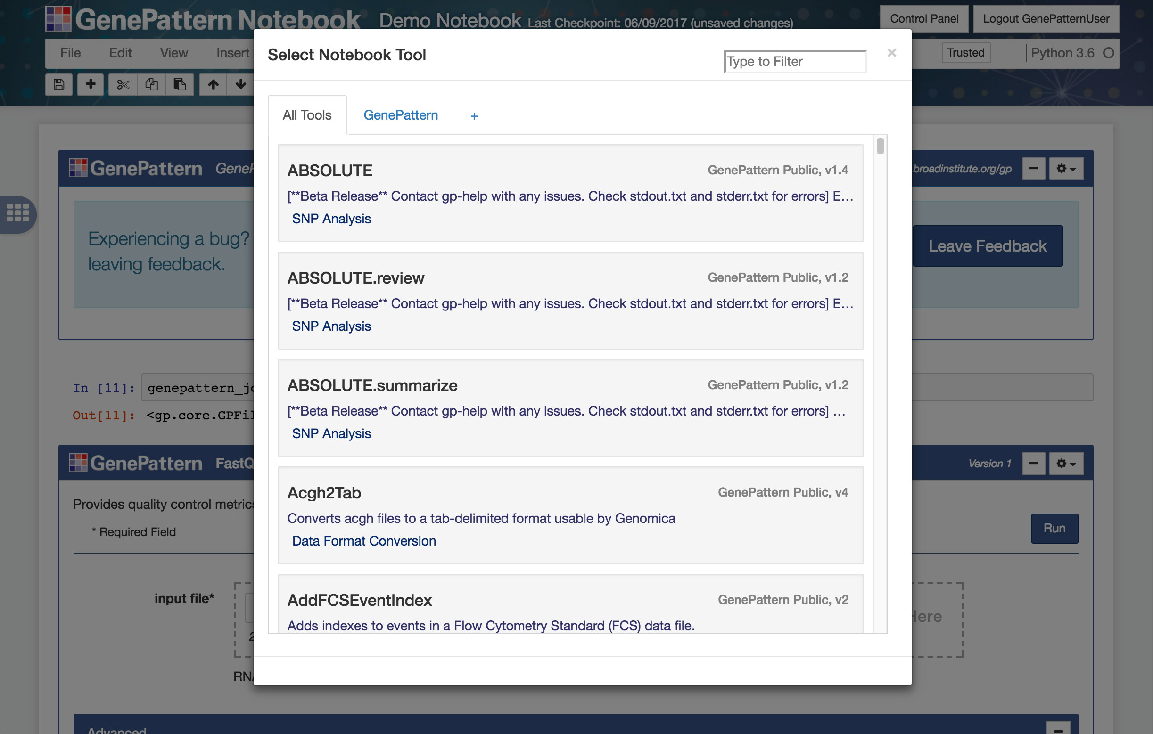
Notebook Tool Manager
Notes:
And here’s where we circle back to GenePattern cells. You can insert a new GenePattern cell by selecting a cell and then changing its type to GenePattern.
.
If you are not yet logged in, this will automatically add an authentication cell. So let’s go ahead and add one of those cells and log in.
.
**Show adding auth cell and logging in**
.
Once you’ve been authenticated, if you do the same thing, changing a cell to a GenePattern cell, this will open the Notebook Tool Manager, which displays all of the available analyses.
.
**Demonstrate adding a GenePattern cell and adding a PreprocessDataset task**
.
Clicking one of these will insert the appropriate analysis in your notebook.

Slide 23
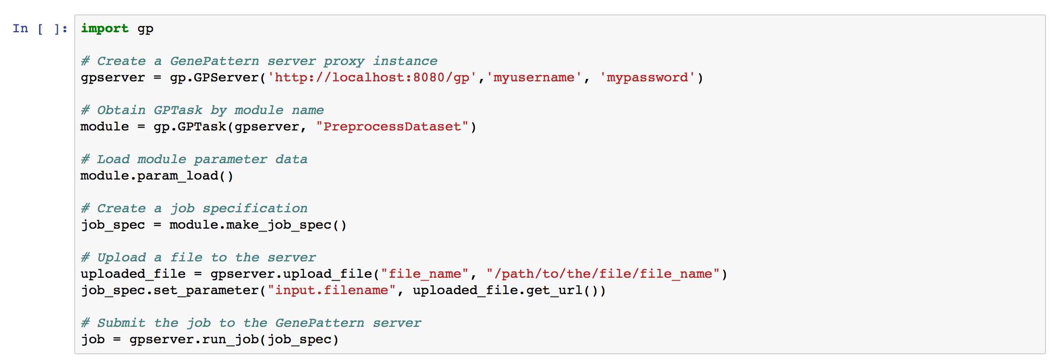
Code Cells
Embed and execute Python code from your browser
Framework supports R and a variety of other languages
Notes:
The final type of cell we’re going to talk about are code cells.
.
Code cells are conceptually pretty simple. They contain some code that can be modified or executed in the notebook.
.
By default this code uses the Python programming language, but support also exists for R, Perl and a variety of other programming languages.
.
If the code in a cell returns a value, the return value will also be displayed.
.
**Show how to insert and run a code cell.**
.
I’m not going to make you type code quite yet – that will come later this afternoon - but I did want to note that code cells exist, and if fact they’re the default type of cell.

Slide 24
GenePattern Python Library
Complete programmatic access
Automatic integration with GenePattern cell data
import gp
# Create a GenePattern server proxy instance
gpserver = gp.GPServer('http://localhost:8080/gp','myusername', 'mypassword')
# Obtain GPTask by module name
module = gp.GPTask(gpserver, "PreprocessDataset")
# Load module parameter data
module.param_load()
# Create a job specification
job_spec = module.make_job_spec()
# Upload a file to the server
uploaded_file = gpserver.upload_file("file_name", "/path/to/the/file/file_name")
job_spec.set_parameter("input.filename", uploaded_file.get_url())
# Submit the job to the GenePattern server
job = gpserver.run_job(job_spec)
Notes:
So speaking of code, I want to take a moment to look behind the scenes.
.
All of the tasks that are performed in a GenePattern Notebook are accessible not only as interactive widgets, such as those you saw earlier, but they’re programmatically accessible as well.
.
This means that if you have coding knowledge, you can also interact with all of your GenePattern data programmatically.
.
For example, I can run an analysis in GenePattern, retrieve the results and then use that data in popular Python libraries like matplotlib, scipy or pandas.
.
This also means that you are not limited by the analyses available in GenePattern. Using GenePattern to run analyses, and coding your own programmatic analyses can be integrated rather seamlessly.

Slide 25
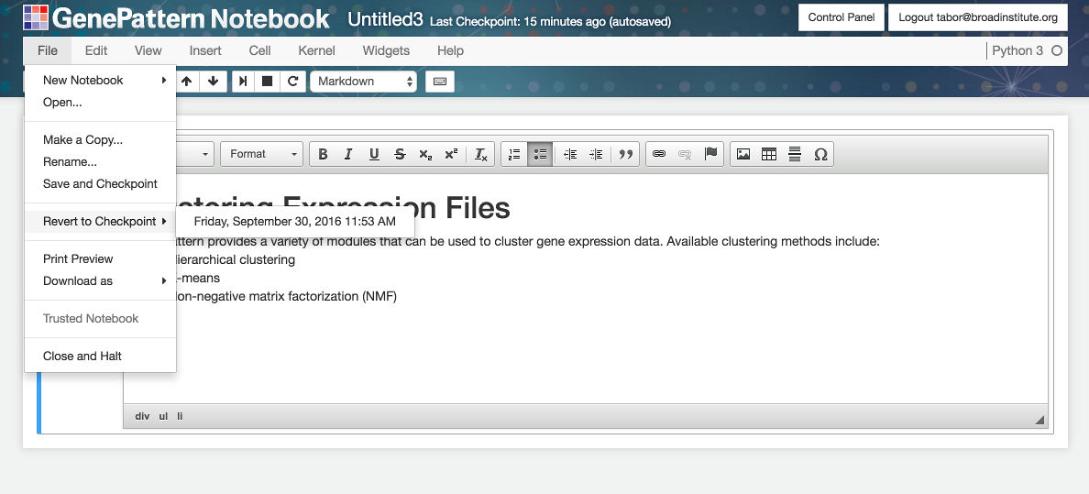
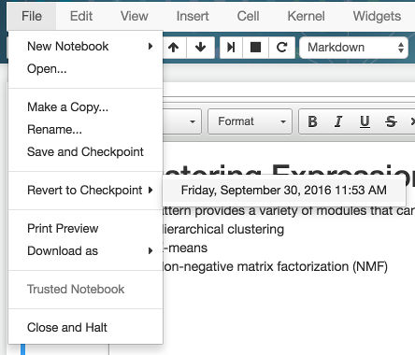
Name, Save & Checkpoint Notebooks
Name or rename notebooks
Save or revert to a checkpoint
Make a duplicate notebook
Notes:
Finally, no discussion of notebook functionality would be complete without mentioning the ability to save, or revert to a saved checkpoint.
.
This works just like saving and checkpointing in Microsoft Word or similar word processor. Both features are available in the File menu at the top of a notebook.
.
You can also name or rename a notebook by clicking on the title at the top, and then giving it a name at the prompt.
.
**Demonstrate these things.**

Slide 26
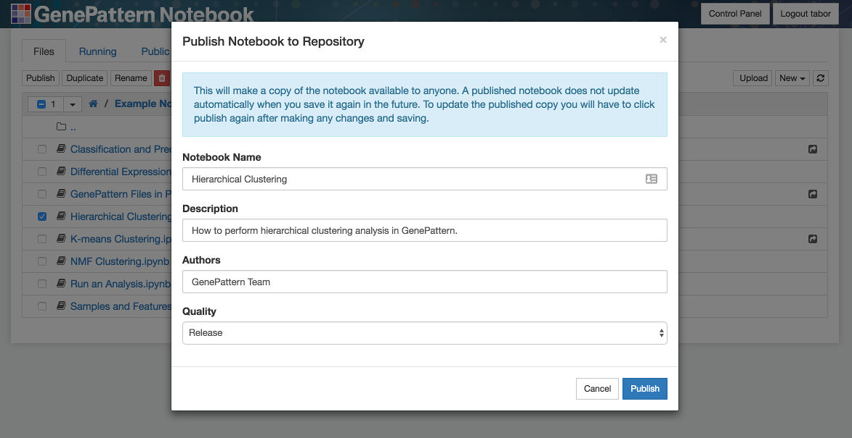
Publish Your Notebooks
You will be able to publish your own notebooks to the GenePattern Notebook Repository.
Share notebooks with others.
Notes:
Earlier we walked through browsing the list of available public notebooks.
.
The notebooks in this list were contributed by some combination of the GenePattern team and the GenePattern Notebook community.
.
In fact, anyone can share their own public notebooks in this way. This is a good way to share your research with others. It can be used to accompany a paper or other publication.

Slide 27
Running GenePattern Notebook
Run using the GenePattern Notebook Repository.
Install on your own computer by installing through the pip or conda package repositories.
A GenePattern Notebook Docker image is available.
Notes:
And now for my final slide of this section of the workshop:
.
I want to note that the GenePattern Notebook environment can be ran in a variety of different ways.
.
The first way you’ve already seen—using the GenePattern Notebook Repository. This method allows you to open a notebook in your browser and run it, no installation required.
.
For those of you who prefer to run notebooks locally, may do so as well. GenePattern Notebook can be installed as an extension for Jupyter, through either the pip or conda package repositories.
.
Finally, we’ve made a Docker image of GenePattern Notebook available. It’s already configured and ready to go. And publicly available on DockerHub..
.
**Introduce Ted for the Data Preparation section.**

